Slide 1
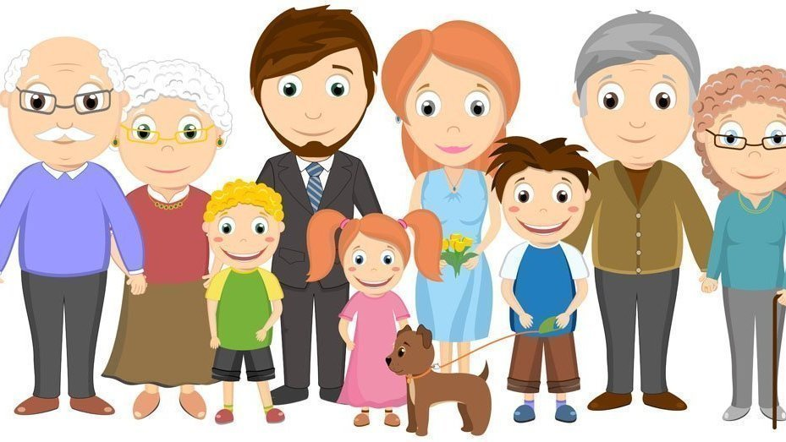

Slide 2
My family

Slide 3
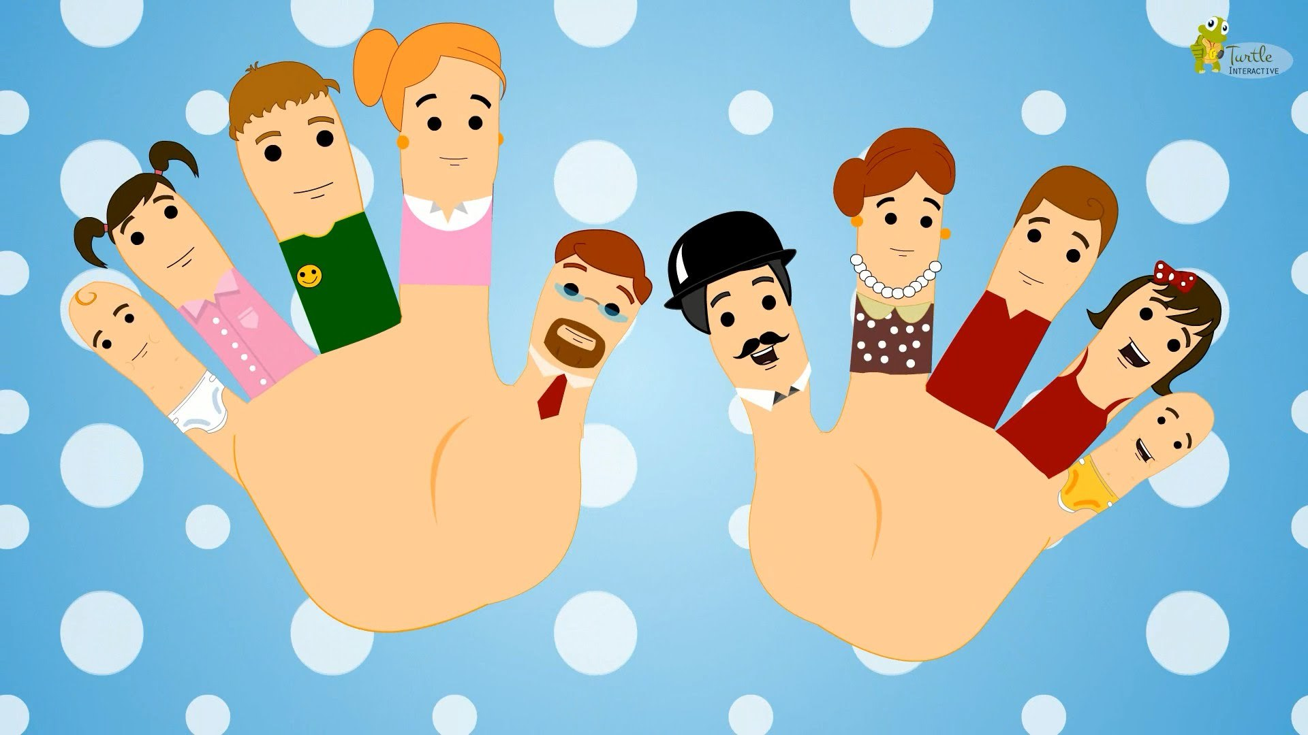

Slide 4
My mother`s name is… My father`s name is… My sister`s name is… My brother`s name is… My uncle`s name is… My aunt`s name is… My grandmother`s name is… My grandfather`s name is… My twins ' names are…

Slide 5
Who is…? How old is…? Who are…? How old are…?

Slide 6
